Slide 1

Review of 2019
&
2019 Awards ceremony

Slide 2
Where does race competition all begin????

Slide 3
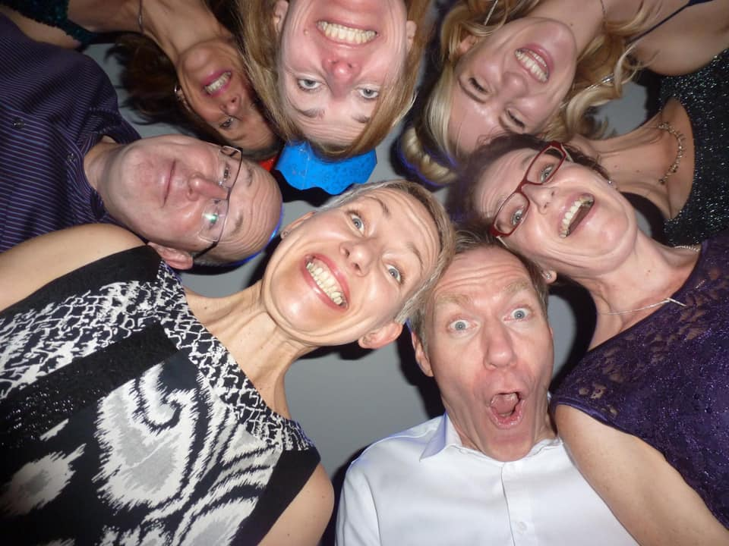
Star studded Xmas party??

Slide 4
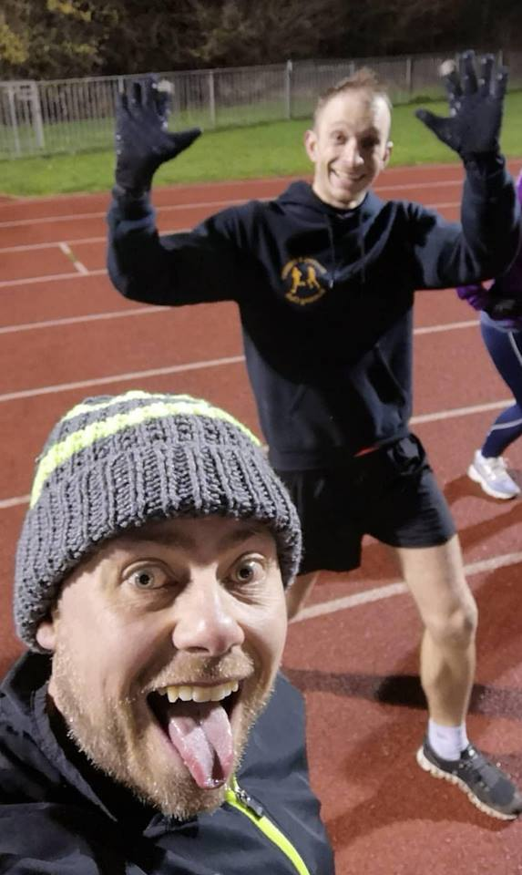
Or the dedicated training sessions?

Slide 5
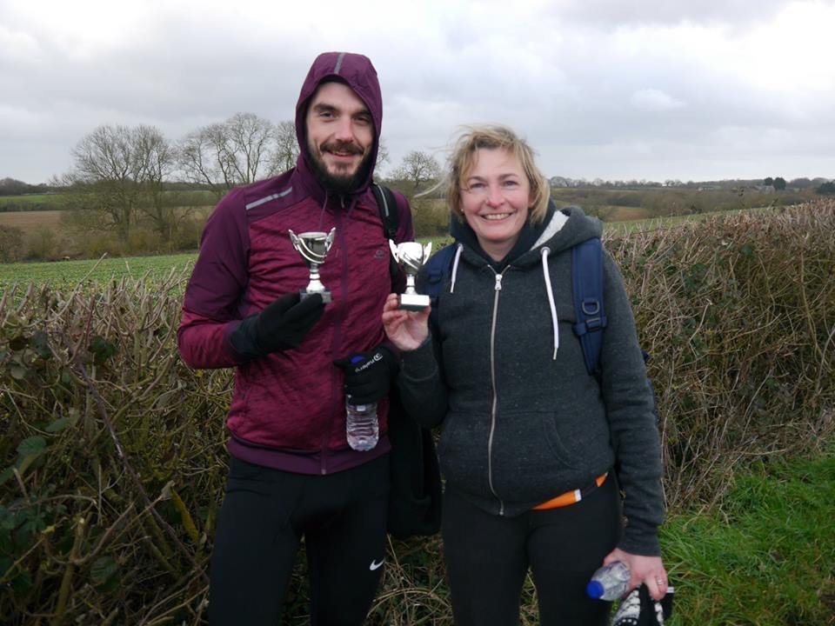

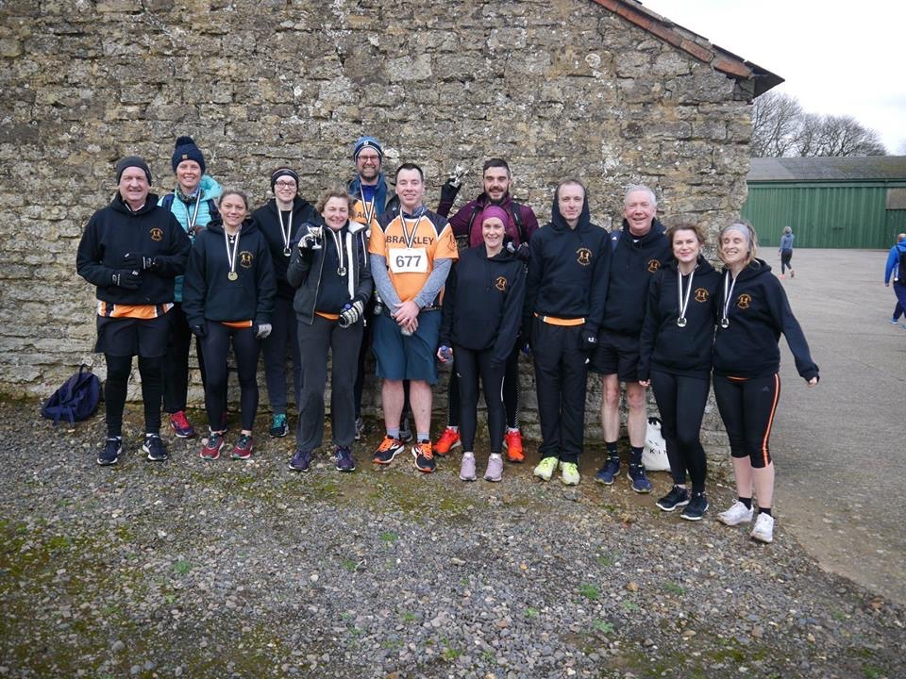
Or does it start with the first trophies of the season??

Slide 6
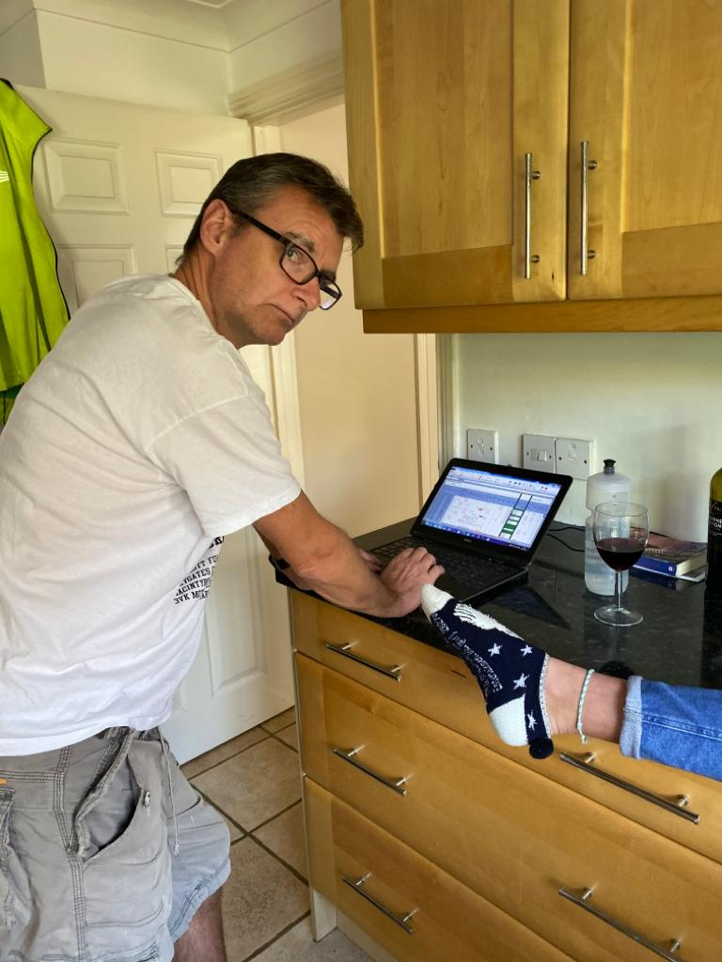
Nah…..this is really where it all begins…YT, in the kitchen with the RNG & Axe

Slide 7
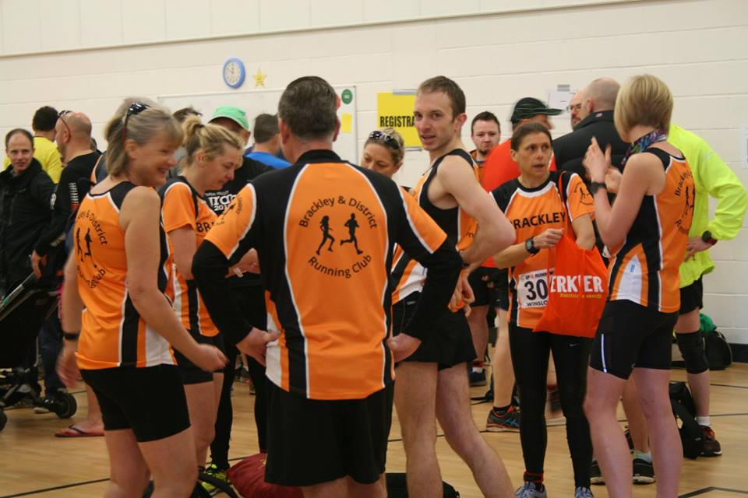
February – Winslow always a winner…with Cornish anyway….

Slide 8
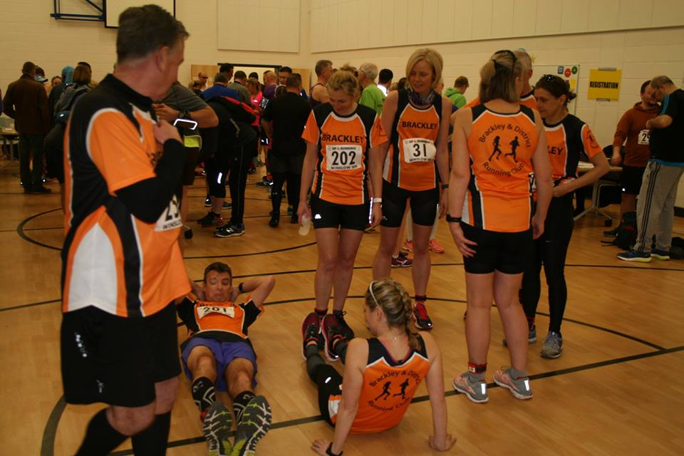
Winslow – What is YT doing rolling around the floor with Heidi???

Slide 9
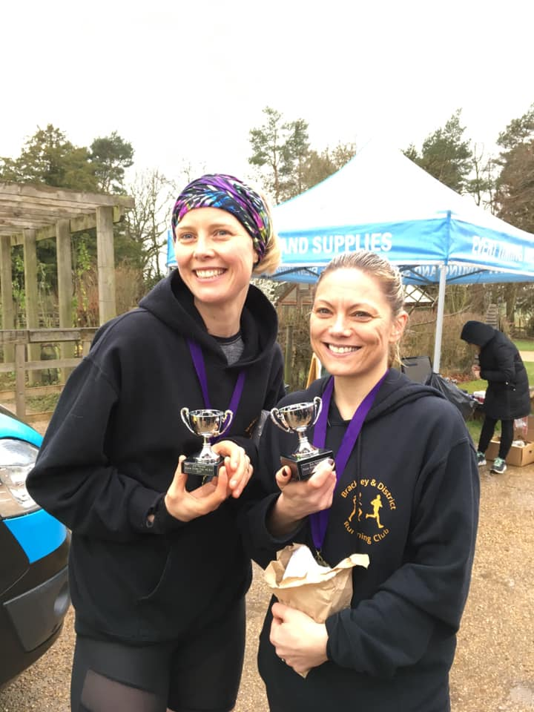
March bling…

Slide 10
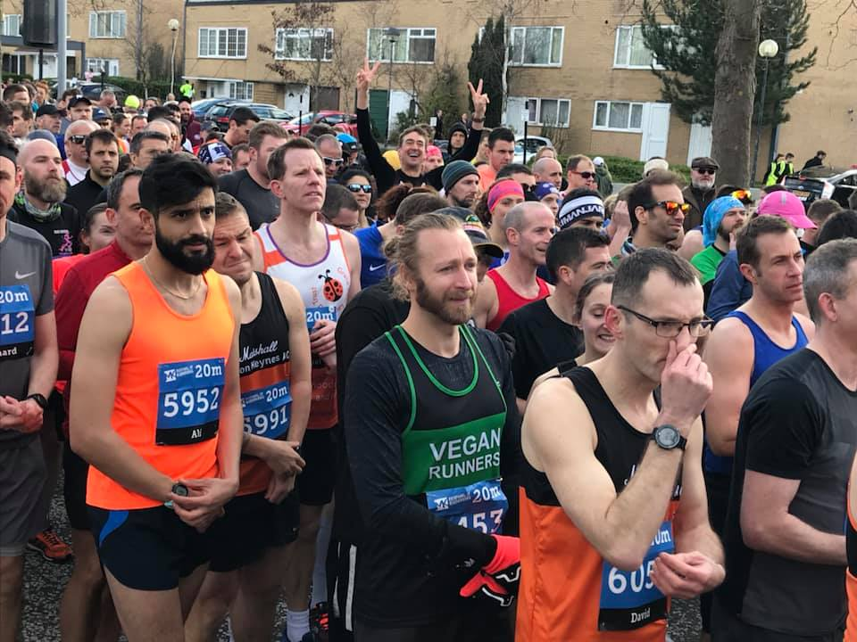
March MK – Where’s Wally?

Slide 11
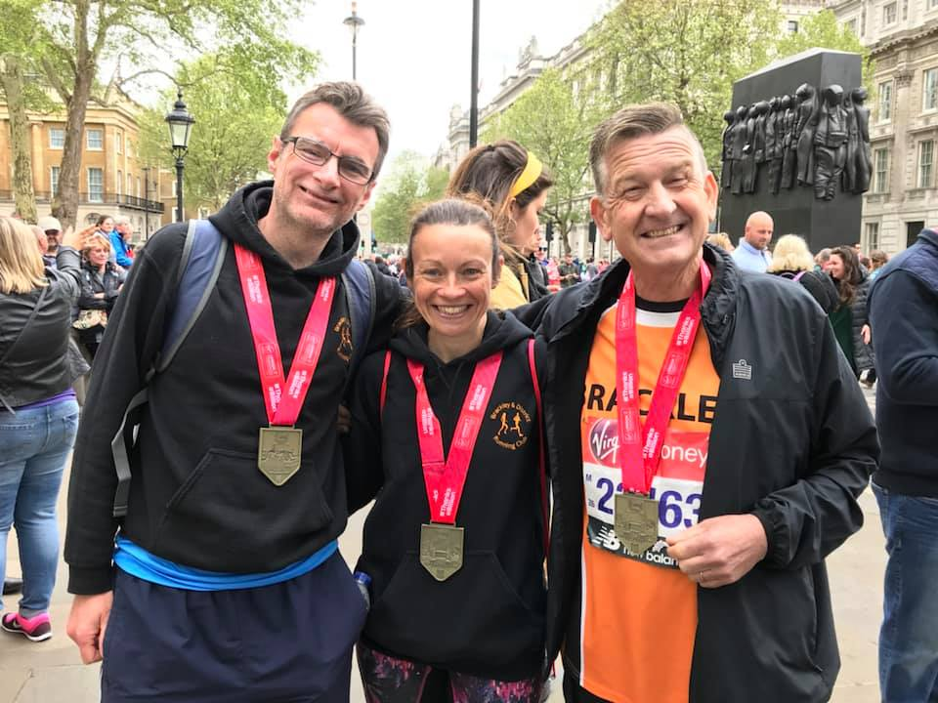
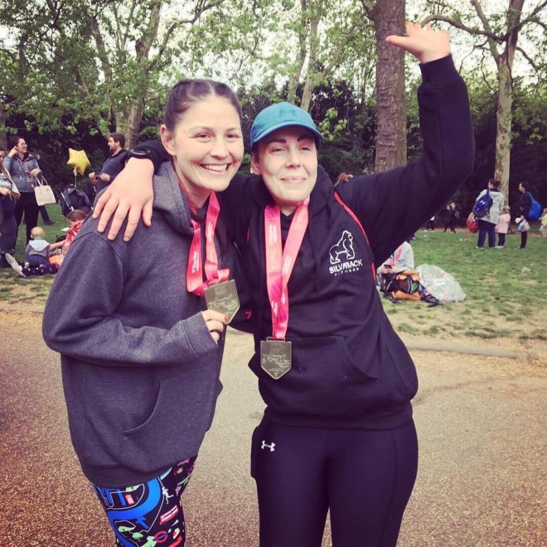
April - VMLM

Slide 12
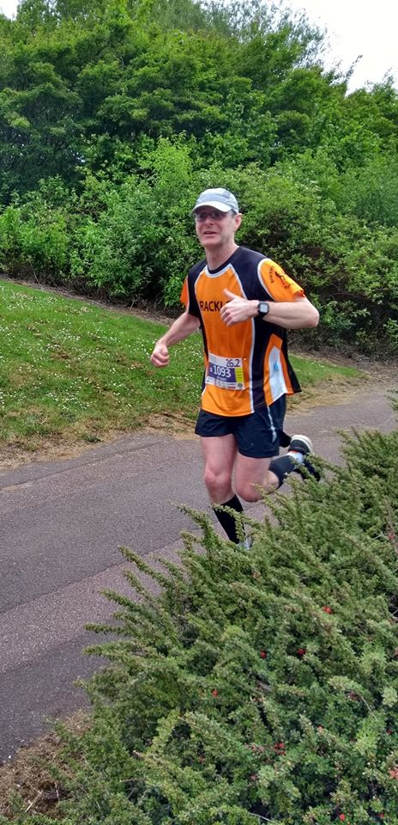
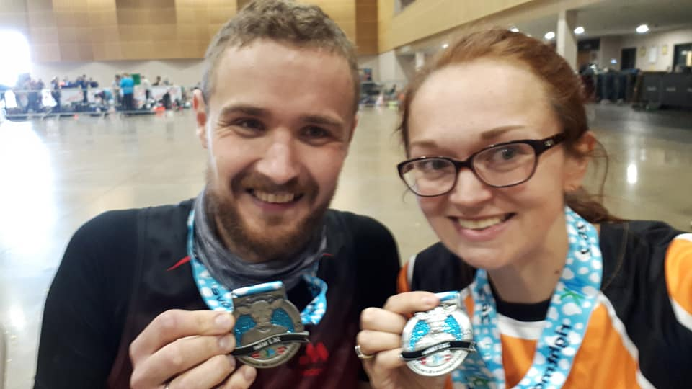
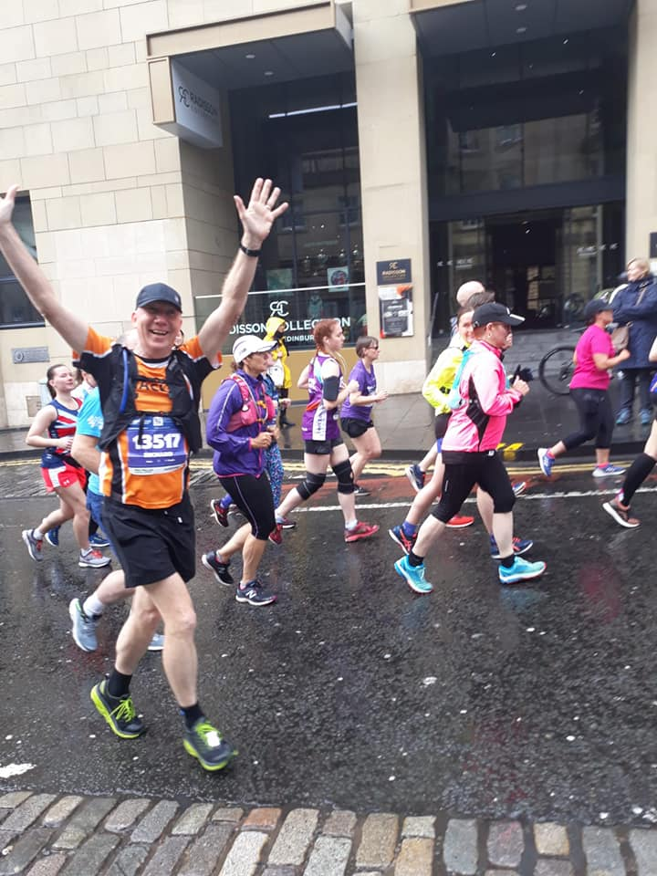
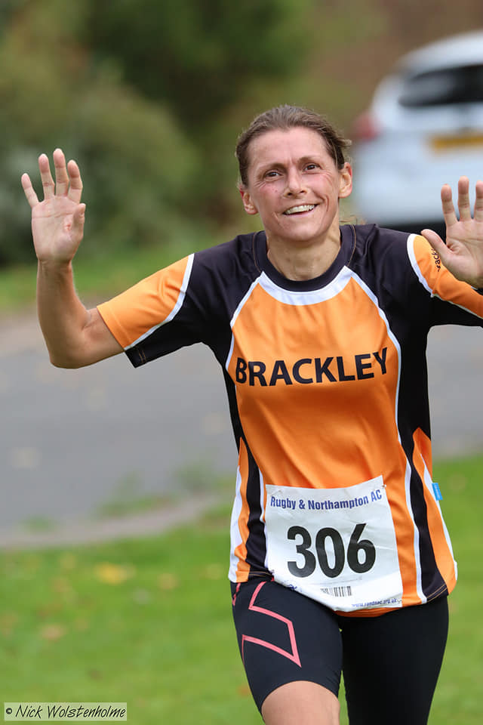
Speaking of first marathons….

Slide 13
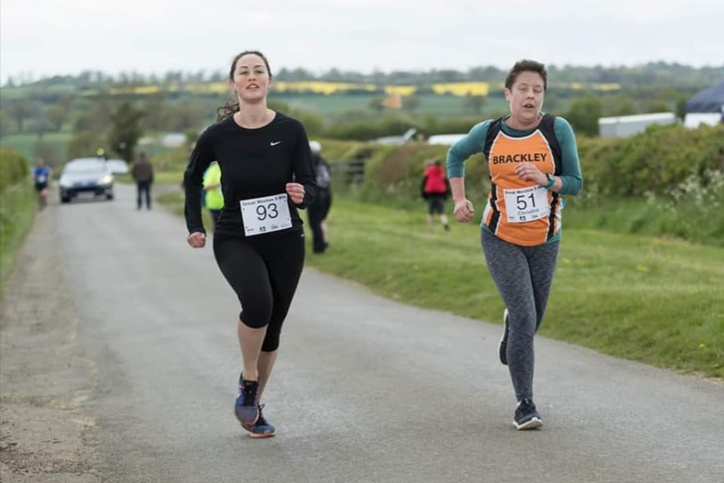
May – Christine “enjoying” running up another hill….

Slide 14
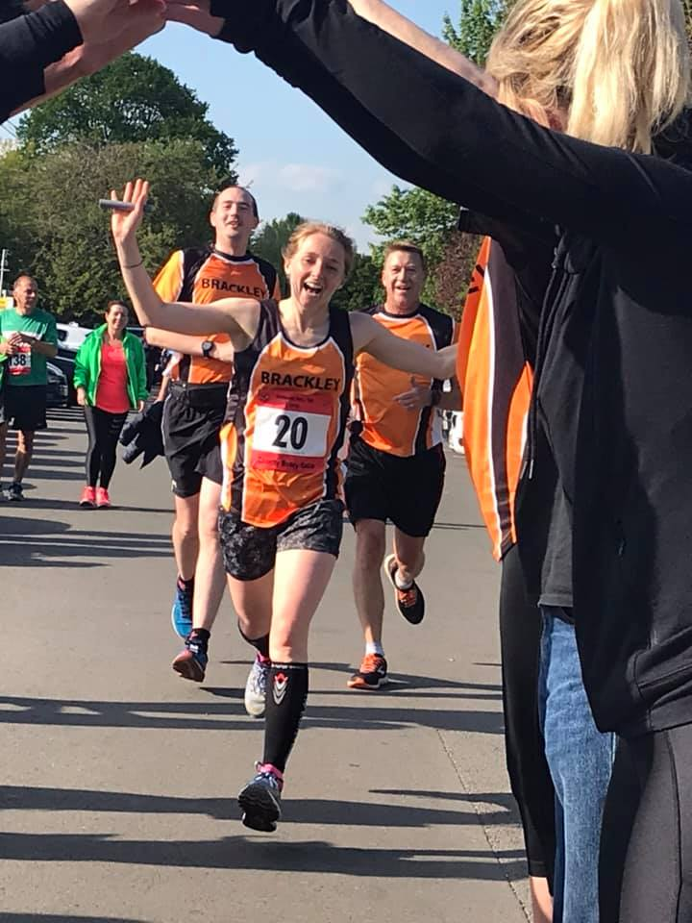
May – Hilly 100…..

Slide 15
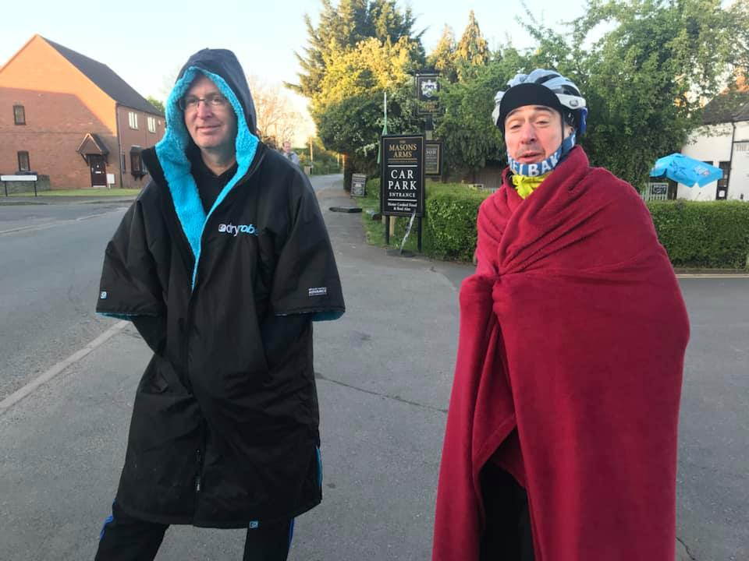
Hilly 100: Modern DryRobe meets “traditional” DryRobe….

Slide 16
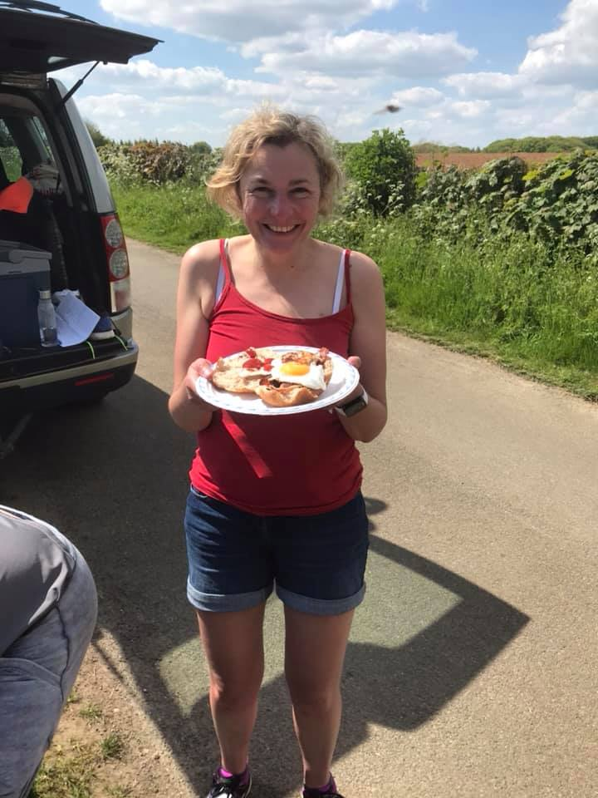
Hilly 100 take 6…first bacon butty..

Slide 17
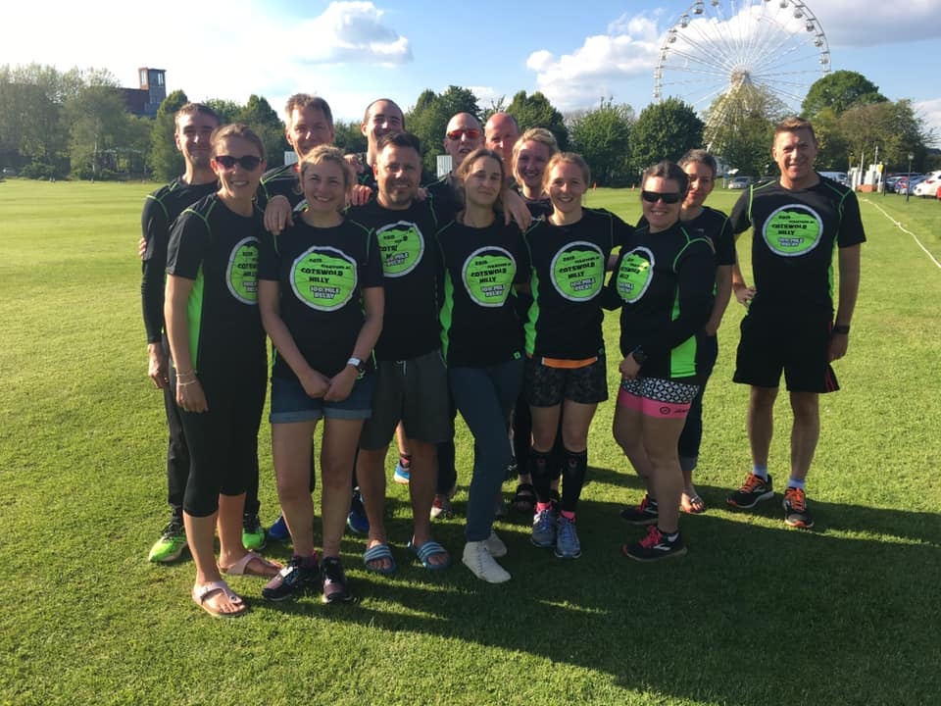
Hilly 100 2019 team

Slide 18
Anyone know what these stats relate to?
101.49 mi
8,602 feet of altitude gain
24:51:44 run time
14:42 min/mi pace

Slide 19
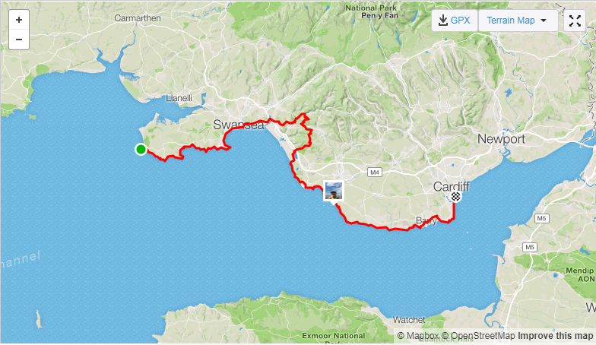
It is of course…..Mazzo’s Dragon race….

Slide 20
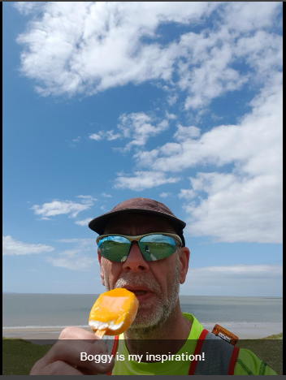
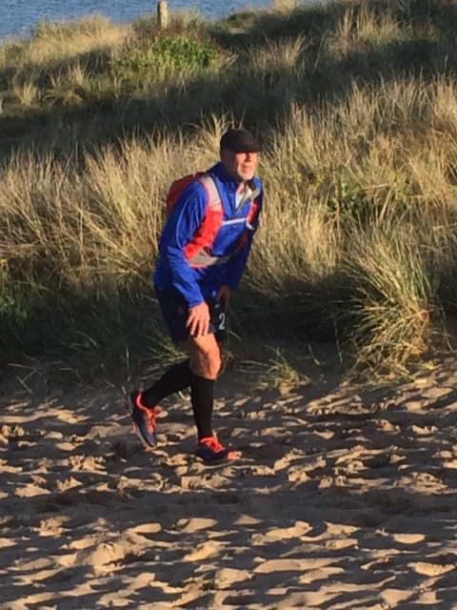
Mazzo’s Dragon race….

Slide 21
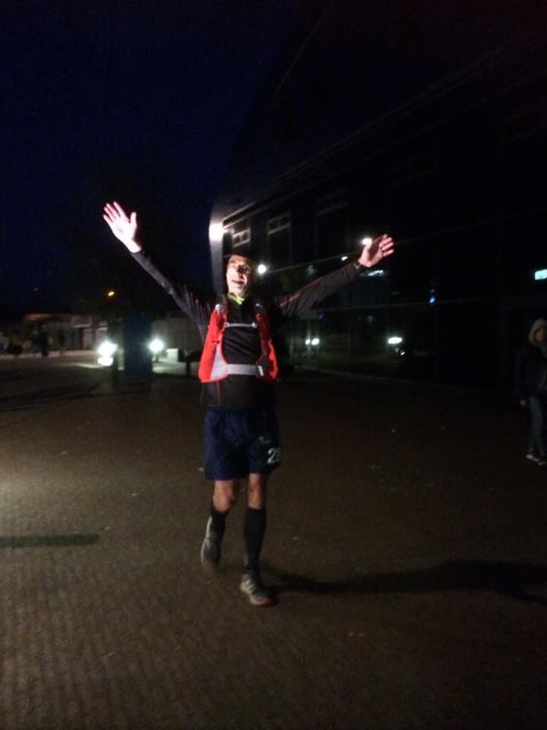
And here he is, at the finish….A remarkable achievement……
…….However…….

Slide 22
For our fabulous Chairzo
….negotiating 100mi race is a piece of piss…..
……..but having a piss afterwards, is definitely not a piece of piss……

Slide 23
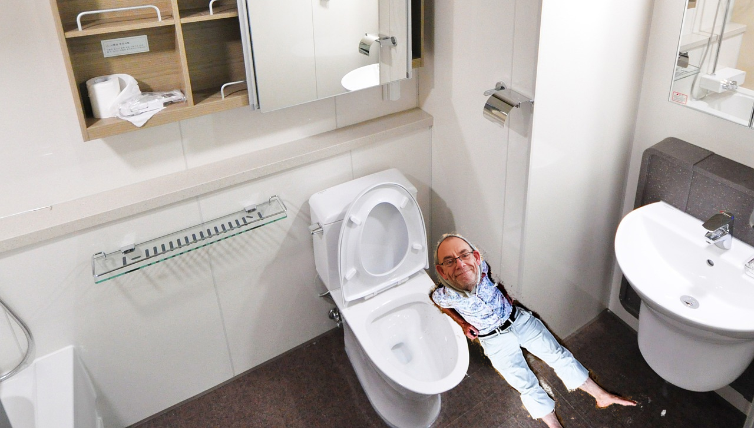
…..little did he know, I was there!

Slide 24
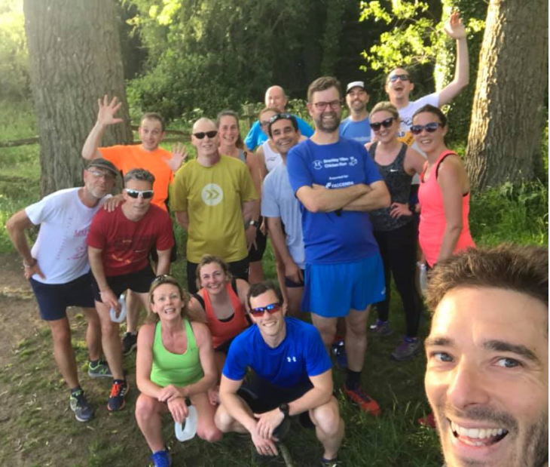
Rolling on into Summer, some BDRC trail running fun…
Lets have a quick game of……..

Slide 25
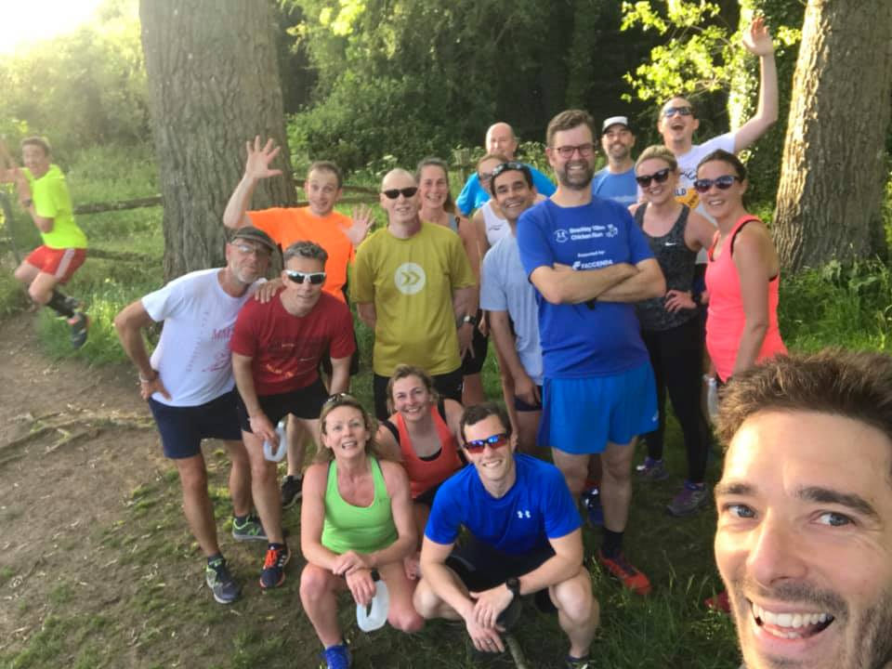
….spot the difference!

Slide 26
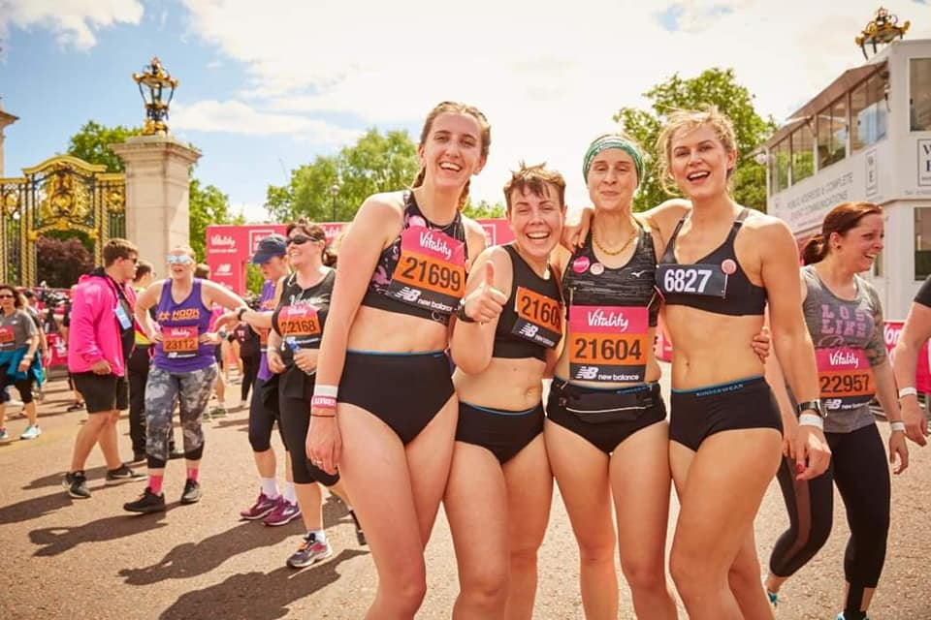
Summer nudes….

Slide 27
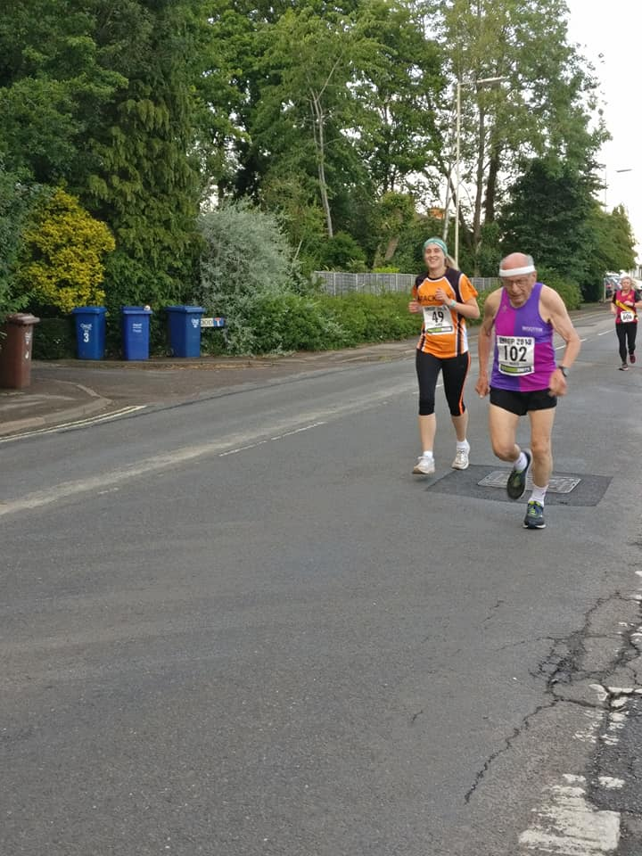
CP#1 continues her battle with the young….

Slide 28
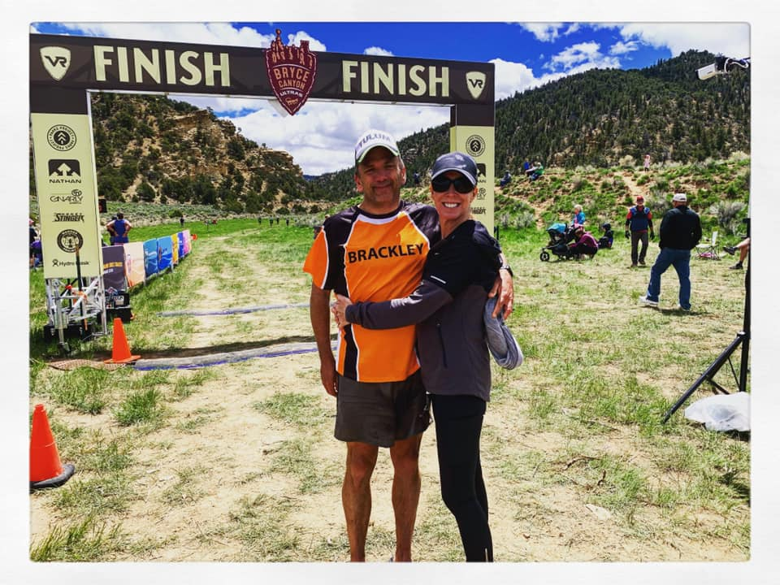
BDRC travel awards…Far Flung Race winner??..Anyone know this chap??

Slide 29
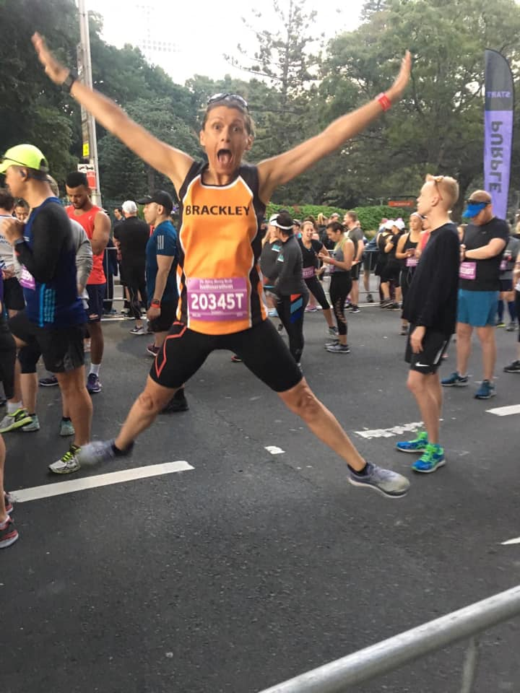
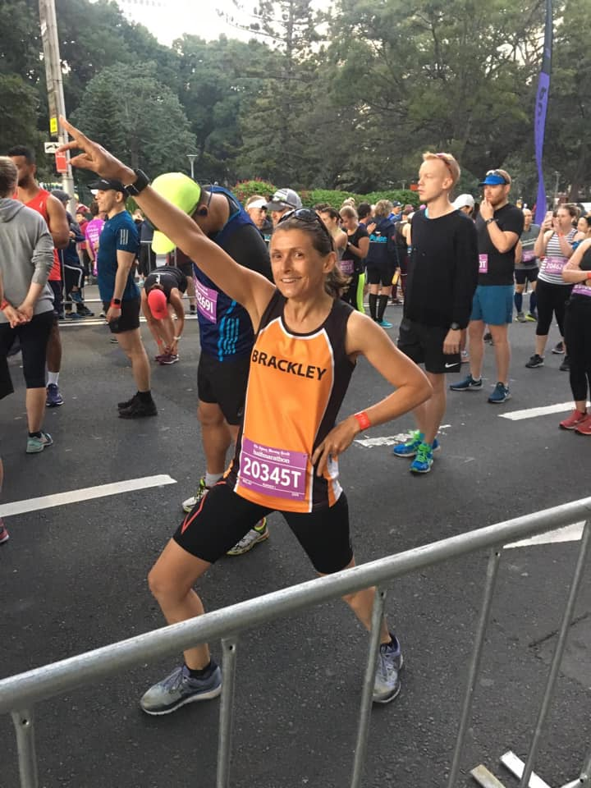
BDRC travel awards for Far Flung Race real winner…..

Slide 30
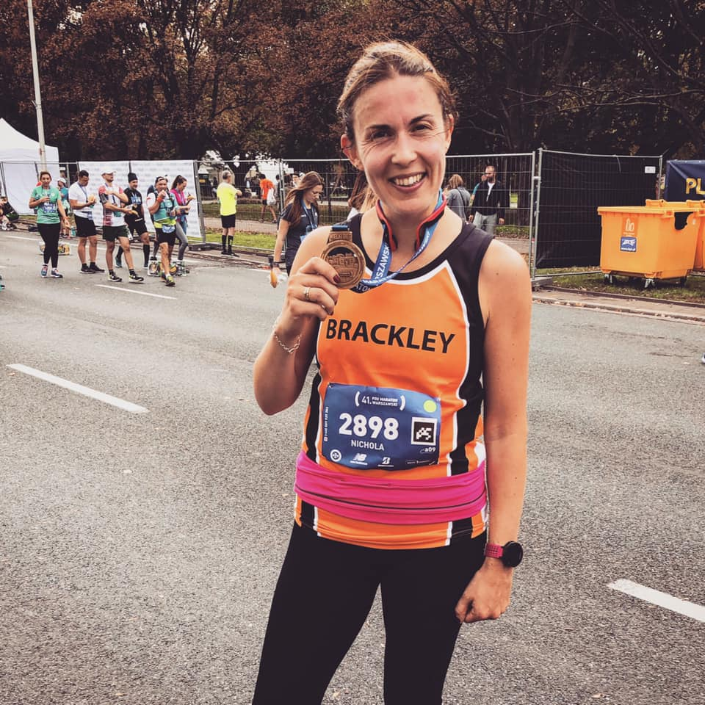
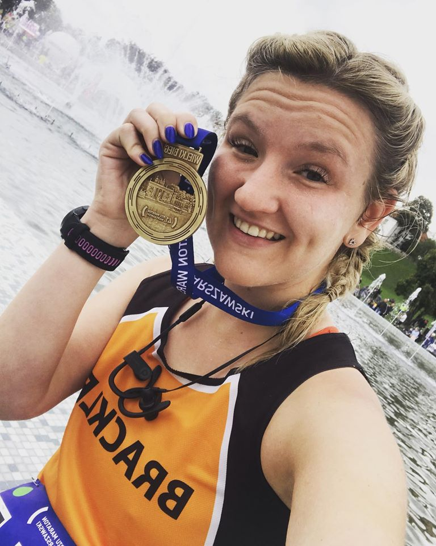
BDRC travel awards……Prolific away racer….

Slide 31
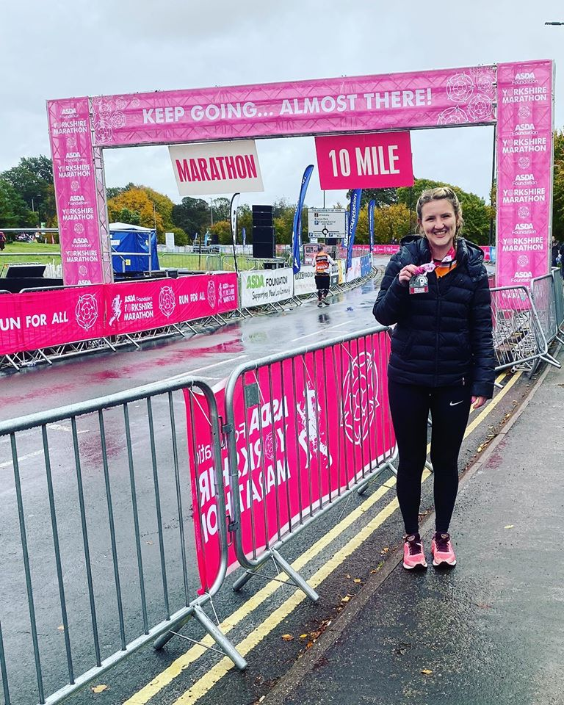

BDRC travel awards……Prolific away racer is ….
Yorkshire is best!!!!
Well done to all our travelling racers!

Slide 32
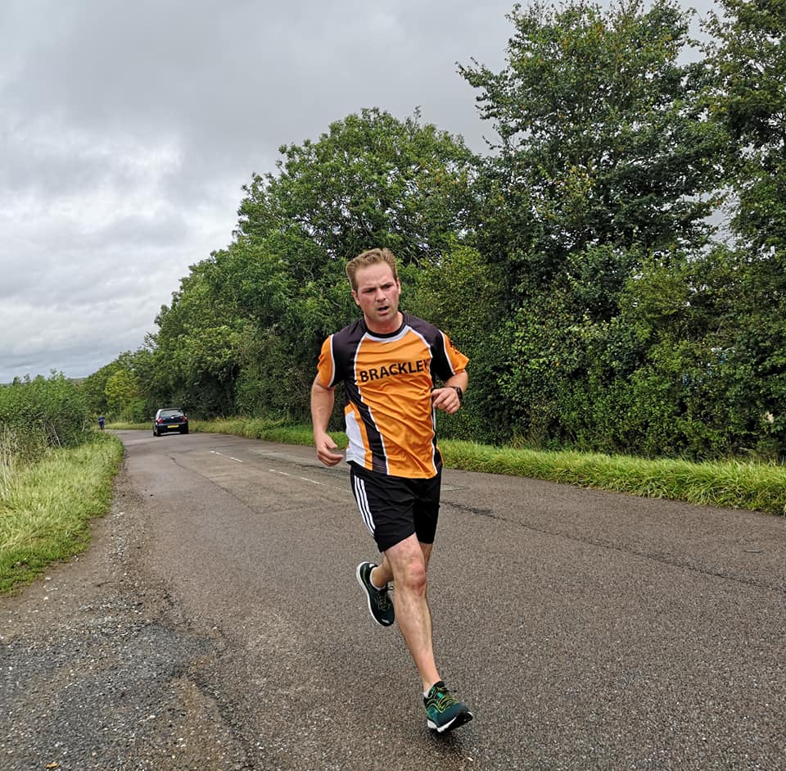
TT 2019!
Our Champ for 2019

Slide 33
TT 2019
Thank you to all TT runners and Marshals….

Slide 34
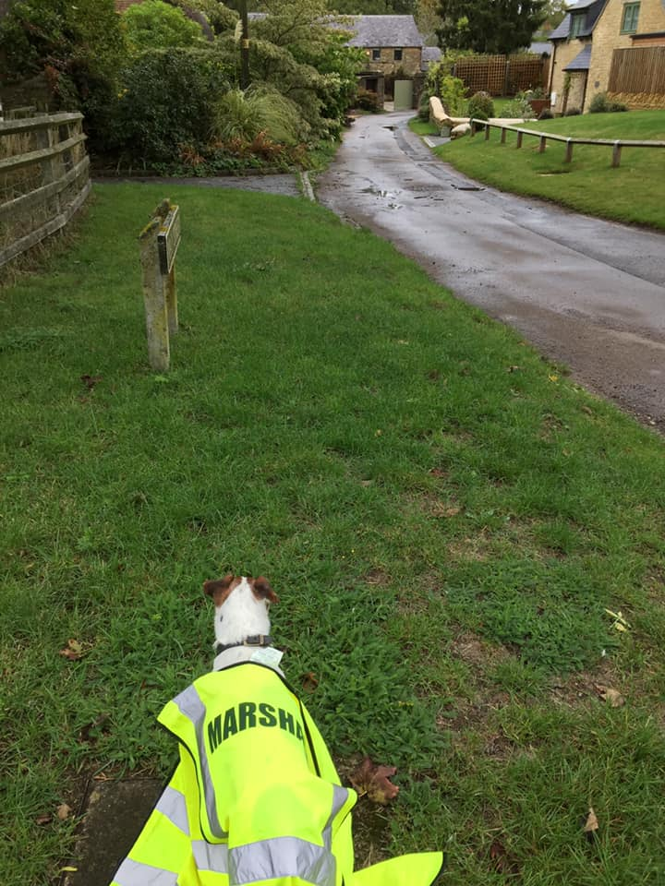
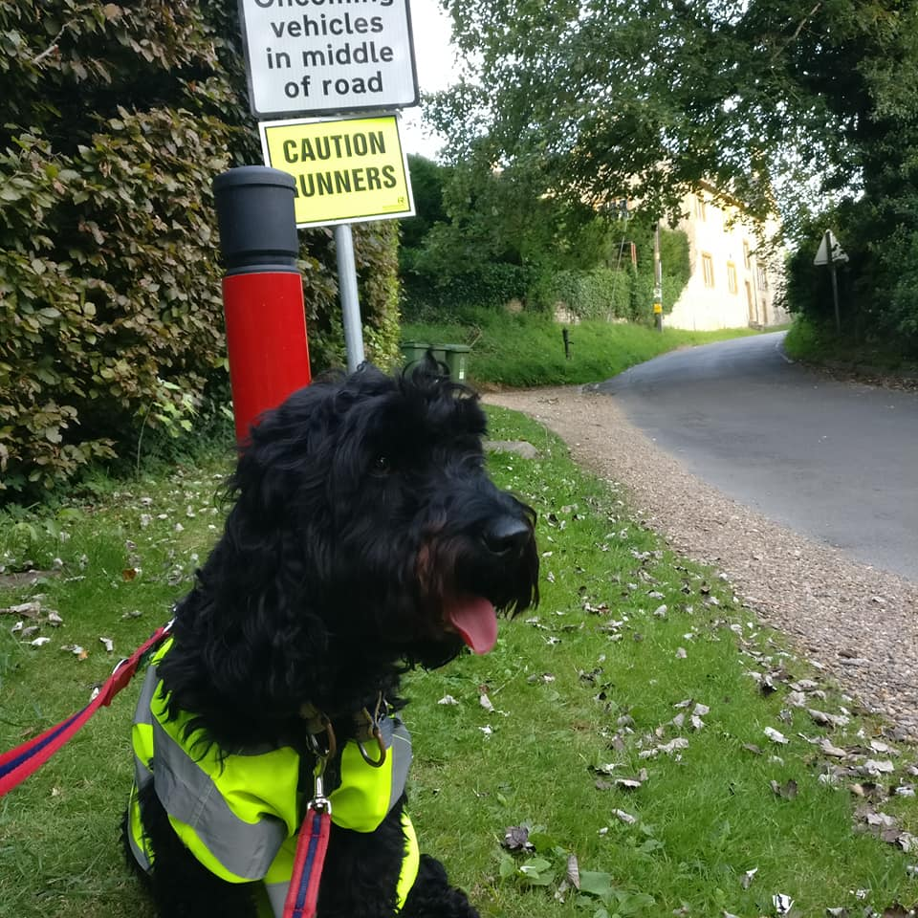
There were however, some right dogs marshalling this year….

Slide 35
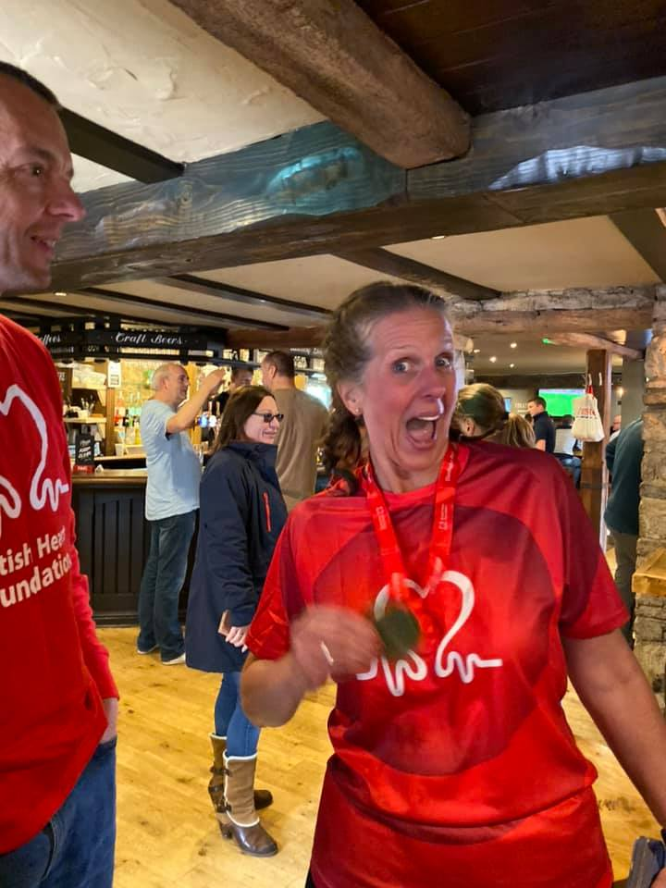

Chezza changes her lens for running gear….Blenheim Half!
…..and raises some serious wedge for BHF…..top marks to the Torros!

Slide 36
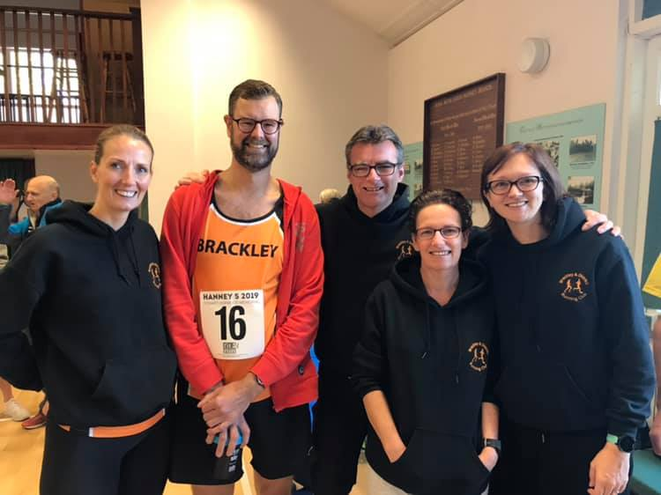

Hanney 5……
…..sorry for screwing up Tommo!

Slide 37
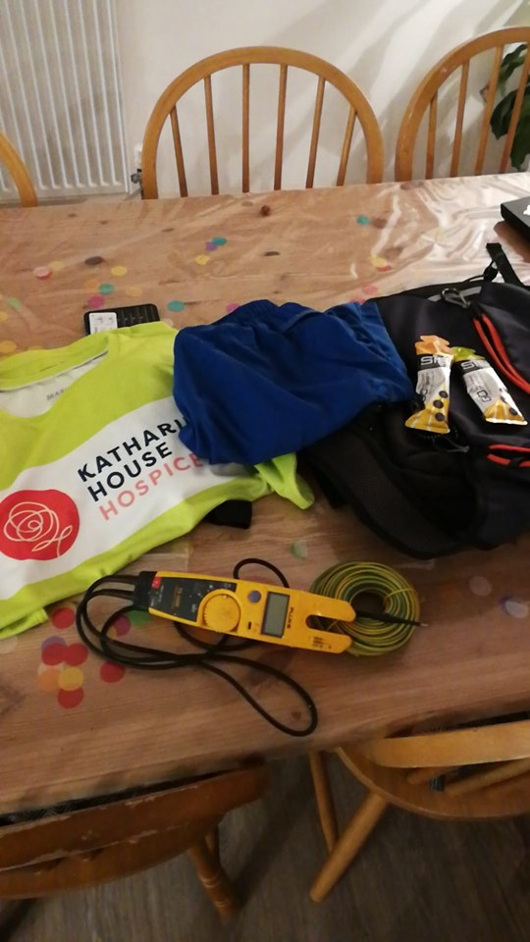
Oxford Half – Tommo’s Prep……..
....and precisely what was the electrometer for Tommo??

Slide 38
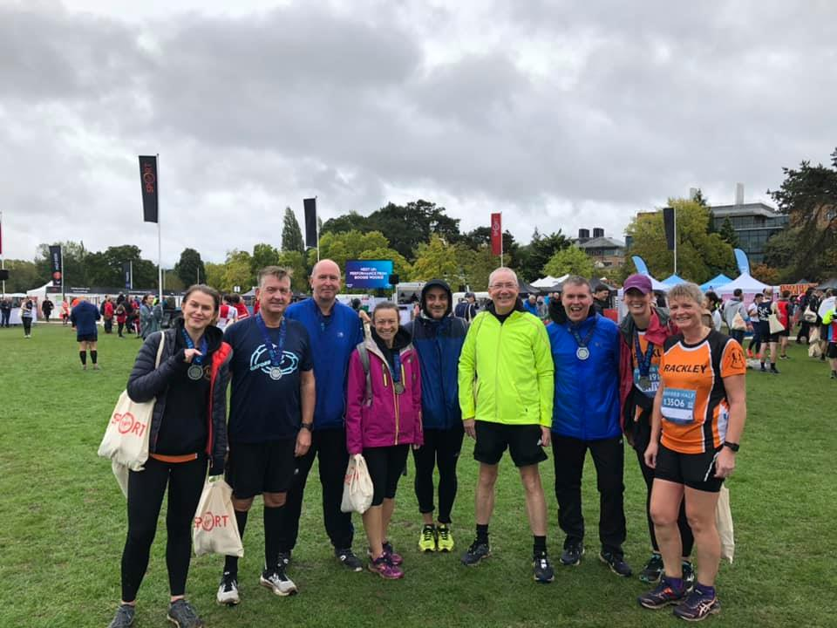
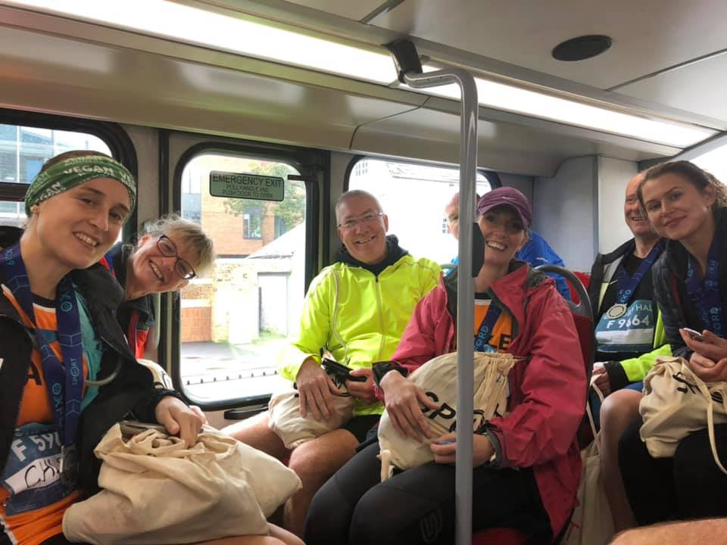
Oxford Half team……..
....and some Oxford Bus wankers…

Slide 39
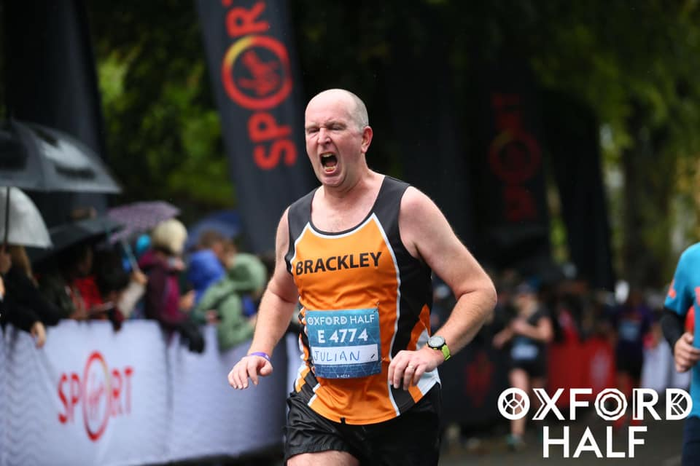
And the photo of the year winner is…..

Slide 40
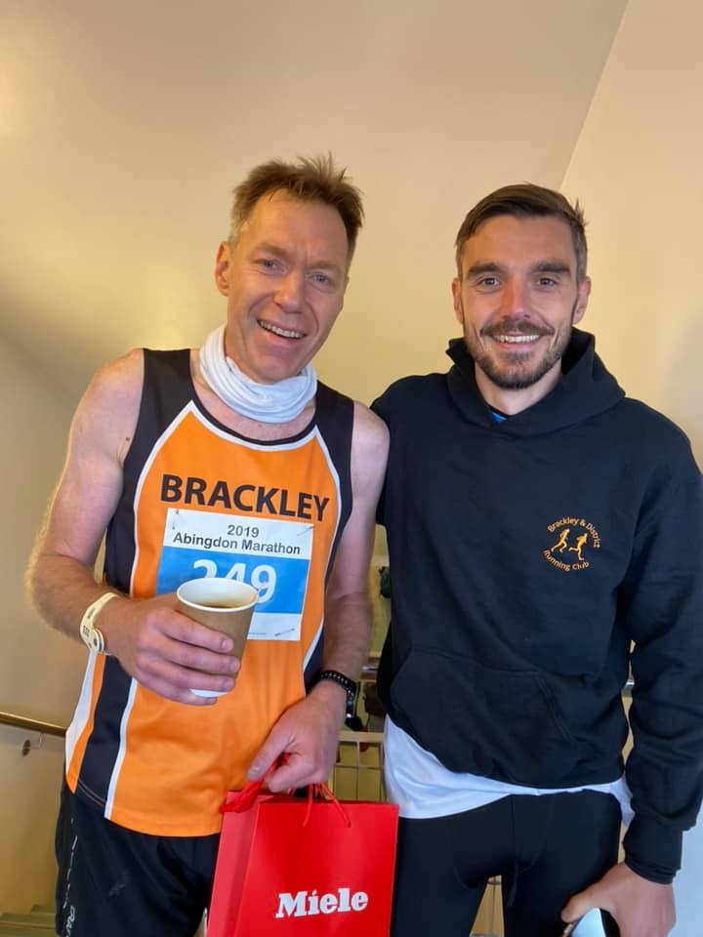
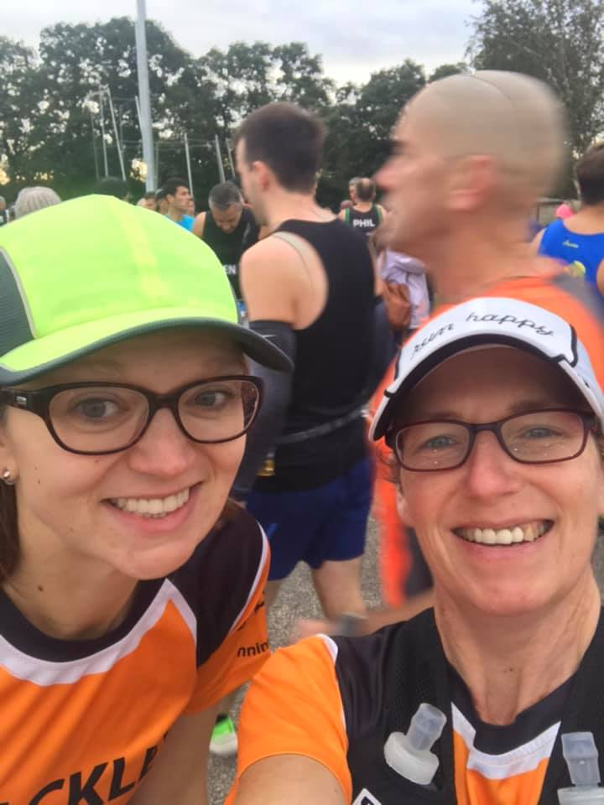
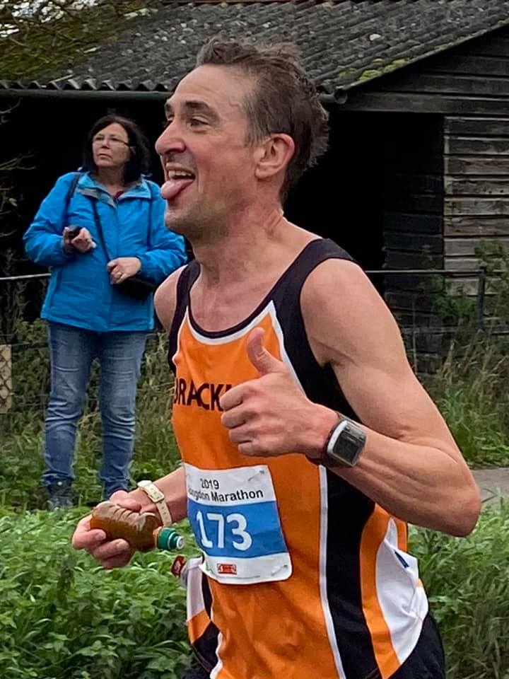
Abingdon Marathon

Slide 41
Race Secretary – handover!
2 pieces of advice to THE POWER:
1. Bring your own set of skills and ideas to the job……….

Slide 42
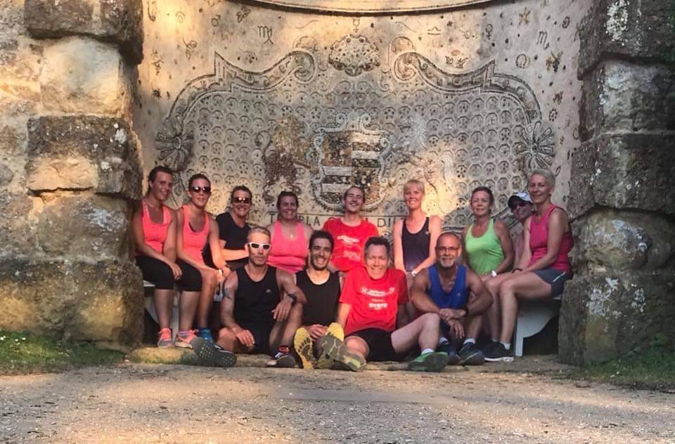
It’s useful to be able to transplant your head….

Slide 43
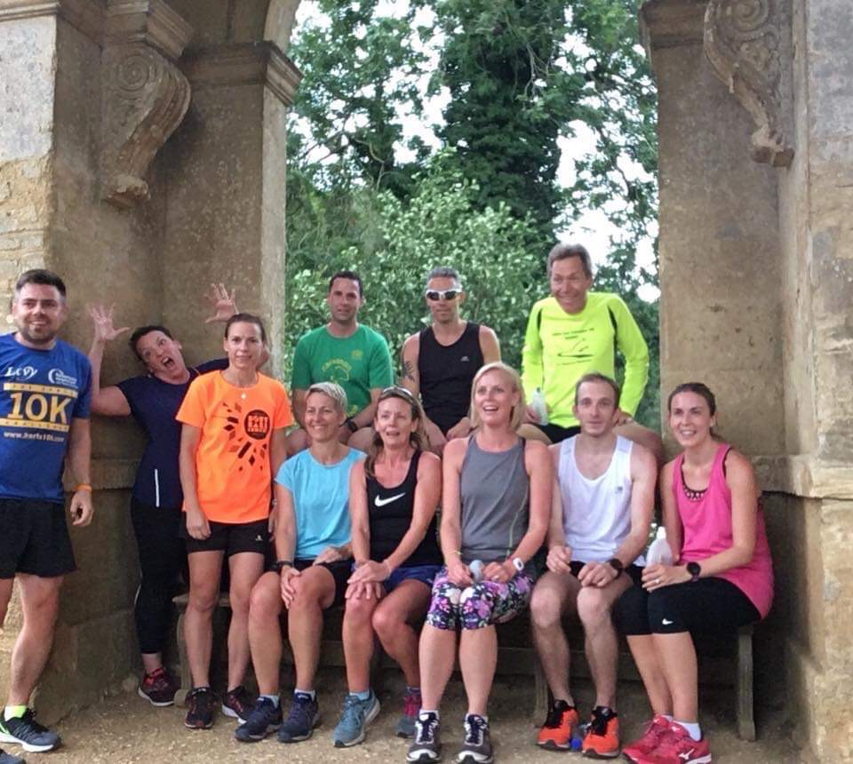
Others just do not possess this skill, you are unique Power….

Slide 44
2. Use the axe liberally to chop times and people……
It is the RC’s prerogative to carry and use the hatchet, wherever and whenever he/she chooses….(Its in the constitution!)

Slide 45
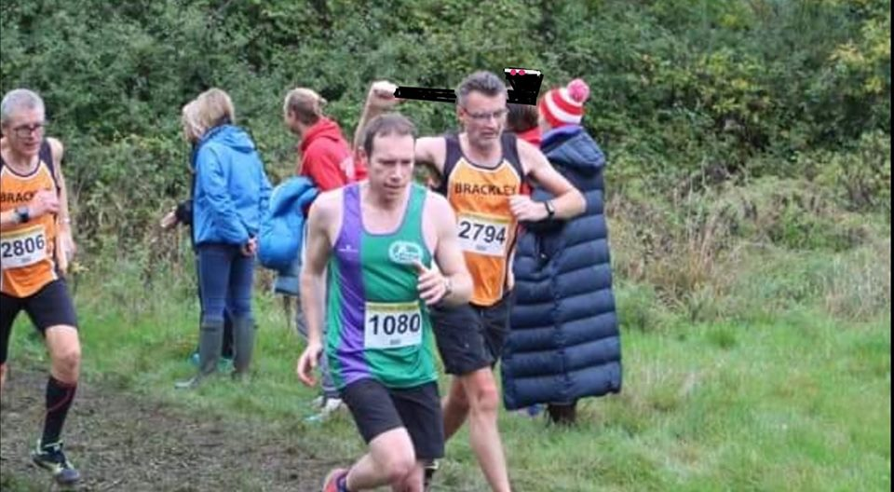
Here it is in action…..

Slide 46
THE END OF 2019
GOOD LUCK EVERYONE IN WHATEVER RACES YOU DO, AND BE KIND TO THE NEW RC!

Slide 47
2019 Awards ceremony

